Slide 1
Chapter 2 From Zero to One (part 1)
Suffolk County Community College
CSE 222, Spring 2020

Slide 2
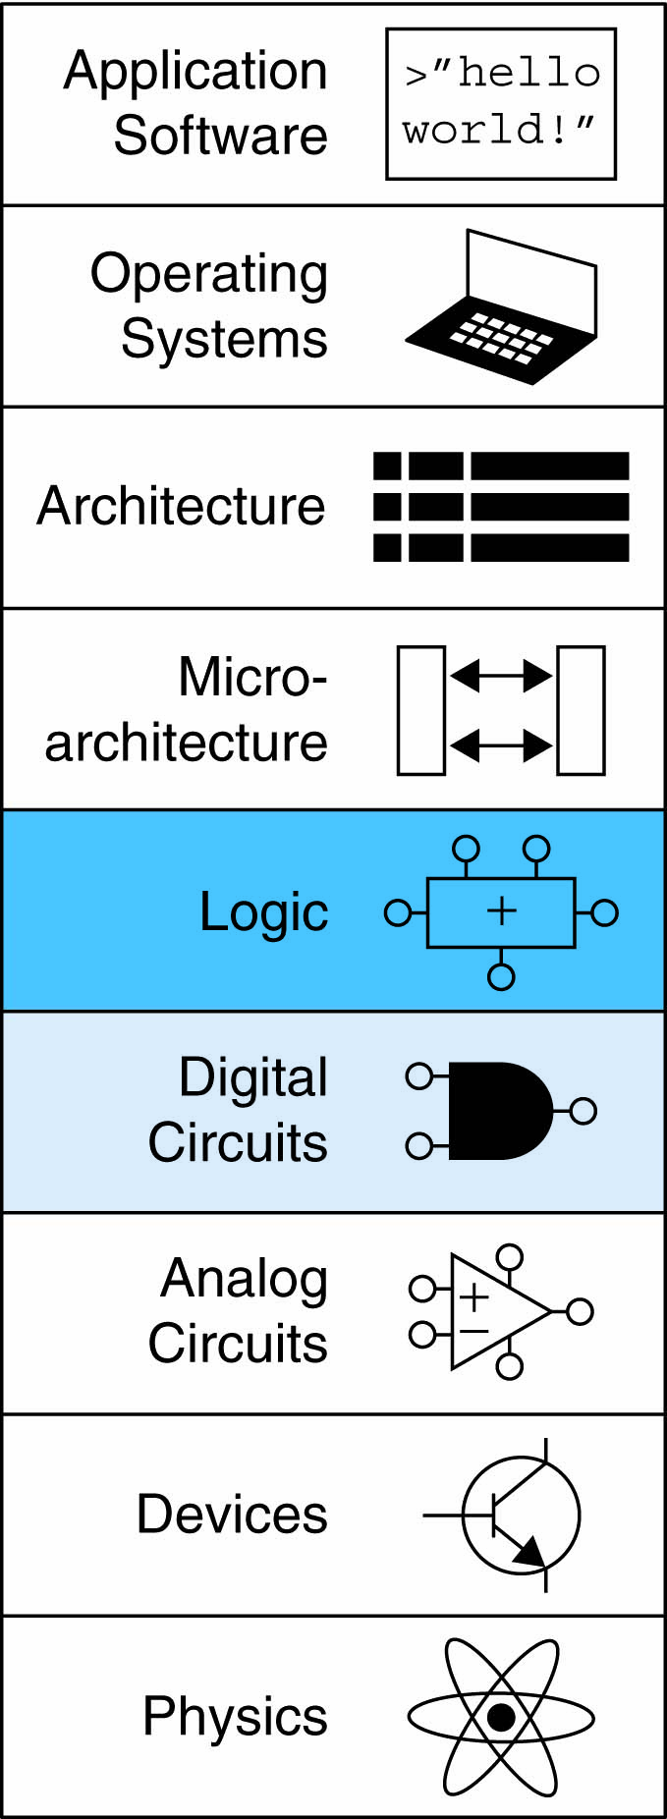
Topics:
Introduction
Boolean Equations
Boolean Algebra
From Logic to Gates
Multilevel Combinational Logic
X’s and Z’s, Oh My
Karnaugh Maps
Combinational Building Blocks
Timing

Slide 3
Introduction
A logic circuit is composed of:
Inputs
Outputs
Functional specification
Timing specification

Slide 4
Circuits
Nodes:
Wire whose voltage conveys a discrete-valued variable
Inputs: A, B, C
Outputs: Y, Z
Internal: n1
Circuit elements
E1, E2, E3
Each a circuit

Slide 5
Circuits
Type of Circuits
Combinational Logic
Memoryless
Outputs determined by current values of inputs
Sequential Logic
Has memory
Outputs determined by previous and current values of inputs

Slide 6
Circuits
Rules of Combinational Composition
Every element is combinational
Every node is either an input or connects to exactly one output
The circuit contains no cyclic paths
Example:

Slide 7
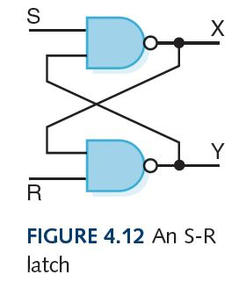
Circuits
Sequential Logic:
Example: Circuits as Memory
An S-R latch stores a single binary digit (1 or 0)
Assume that S and R are never both 0 at the same time
The design of this circuit guarantees that the two outputs X and Y are always complements of each other
The value of X at any point in time is considered to be the current state of the circuit
Therefore, if X is 1, the circuit is storing a 1; if X is 0, the circuit is storing a 0

Slide 8
Boolean Equations
Functional specification of outputs in terms of inputs
Example:
S = F(A, B, C_{in})
C_{out} = F(A, B, C_{in})

Slide 9
Boolean Equations
Definitions
Complement: variable with a bar over it
A, B, C
Literal: variable or its complement
A, A, B, B, C, C
Implicant: product of literals
ABC, AC, BC
Minterm: product that includes all input variables
ABC, ABC, ABC
Maxterm: sum that includes all input variables
(A+B+C), (A+B+C), (A+B+C)

Slide 10
Sum-of-Products (SOP) Form
All equations can be written in SOP form
Each row has a minterm
A minterm is a product (AND) of literals
Each minterm is TRUE for that row (and only that row)
Form function by ORing minterms where the output is TRUE
Thus, a sum (OR) of products (AND terms)
Y = F(A, B) =

Slide 11
Sum-of-Products (SOP) Form
All equations can be written in SOP form
Each row has a minterm
A minterm is a product (AND) of literals
Each minterm is TRUE for that row (and only that row)
Form function by ORing minterms where the output is TRUE
Thus, a sum (OR) of products (AND terms)
Y = F(A, B) =

Slide 12
Sum-of-Products (SOP) Form
All equations can be written in SOP form
Each row has a minterm
A minterm is a product (AND) of literals
Each minterm is TRUE for that row (and only that row)
Form function by ORing minterms where the output is TRUE
Thus, a sum (OR) of products (AND terms)
Y = F(A, B) = AB + AB = Σ(1, 3)

Slide 13
Product-of-Sums (POS) Form
All Boolean equations can be written in POS form
Each row has a maxterm
A maxterm is a sum (OR) of literals
Each maxterm is FALSE for that row (and only that row)
Form function by ANDing maxterms for which output is FALSE
Thus, a product (AND) of sums (OR terms)
Y = F(A, B) = (A + B)(A + B) = Π(0, 2)

Slide 14
Boolean Equations Example
Example: going to the cafeteria for lunch
You won’t eat lunch (E):
If it’s not open (O) or
If they only serve corndogs (C)
Write a truth table for determining if you will eat lunch (E)

Slide 15
Boolean Equations Example
Example: going to the cafeteria for lunch
You won’t eat lunch (E):
If it’s not open (O) or
If they only serve corndogs (C)
Write a truth table for determining if you will eat lunch (E)

Slide 16
SOP & POS Forms
SOP – sum-of-products
POS – product-of-sums

Slide 17
SOP & POS Forms
SOP – sum-of-products
POS – product-of-sums
Y = OC
= Σ(2)
Y = (O + C)(O + C)(O + C)
= Π(0, 1, 3)

Slide 18
Boolean Algebra
Axioms and theorems to simplify Boolean equations
Like regular algebra, but simpler: variables have only two values (1 or 0)
Duality in axioms and theorems:
ANDs and ORs, 0’s and 1’s interchanged

Slide 19
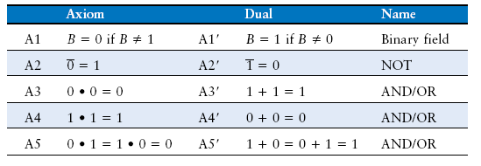
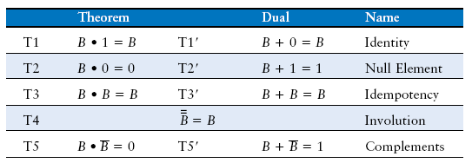
Boolean Axioms

Slide 20
T1: Identity Theorem
B · 1 = B
B + 0 = B

Slide 21
T2: Null Element Theorem
B · 0 = 0
B + 1 = 1

Slide 22
T3: Idempotency Theorem
B · B = B
B + B = B

Slide 23
T4: Identity Theorem
B = B

Slide 24
T5: Complement Theorem
B · B = 0
B + B = 1

Slide 25
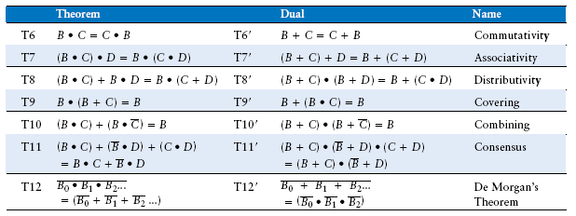
Boolean Theorems of Several Vars

Slide 26
T12: DeMorgan’s Theorem
Y = AB = A + B
Y = A + B = A B
Notes:
NAND gate is equivalent to an OR gate with inverted inputs
NOR gate is equivalent to an AND gate with inverted inputs

Slide 27
Simplifying Boolean Equations
Example 1:
Y = AB + AB

Slide 28
Simplifying Boolean Equations
Example 1:
Y = AB + AB
= (A+A)B
= (1) B
= B

Slide 29
Simplifying Boolean Equations
Example 2:
Y = A(AB + ABC)

Slide 30
Simplifying Boolean Equations
Example 2:
Y = A(AB + ABC)
= A(AB(1+C)
= A(AB(1))
= A(AB)
= (AA)B
= AB

Slide 31
“Bubble Pushing”
CMOS circuits prefer NANDs and NORs than ANDs and ORs
The inversion circle is called “bubble”
“bubble pushing” – pushing a bubble through the gate
Pushing backward:
Body changes
Adds bubbles to inputs
Pushing forward:
Body changes
Adds bubble to output
Notes:
Complementary metal–oxide–semiconductor (CMOS)

Slide 32
“Bubble Pushing”
Example 1:
Y = ?
Pushing the bubble:
Y = AB + CD

Slide 33
“Bubble Pushing”
Example:
Y = ?
Pushing the bubble:
Y = AB + CD

Slide 34
Bubble Pushing Rules
Begin at output, then work toward inputs
Push bubbles on final output back
Draw gates in a form so bubbles cancel
Example:

Slide 35
Applying Bubble Pushing Rules

Slide 36
From Logic to Gates
Two-level logic: ANDs followed by ORs
Example:
Notes:
PLA: programmable logic array

Slide 37
Circuit Schematics Rules
Inputs on the left (or top)
Outputs on right (or bottom)
Gates flow from left to right
Straight wires are best (use ruler)
Wires always connect at a T junction
A dot where wires cross indicates a connection between wires
Wires crossing without a dot make no connection

Slide 38
Multiple-Output Circuits
Example: Priority Circuit
Output asserted corresponding
to most significant TRUE input

Slide 39
Multiple-Output Circuits
Example: Priority Circuit
Output asserted corresponding
to most significant TRUE input

Slide 40
Priority Circuit Hardware

Slide 41
Don’t Care

